Slide 1
Feasibility for RNA-seq prostate cancer
Ashfaq Ali

Slide 2
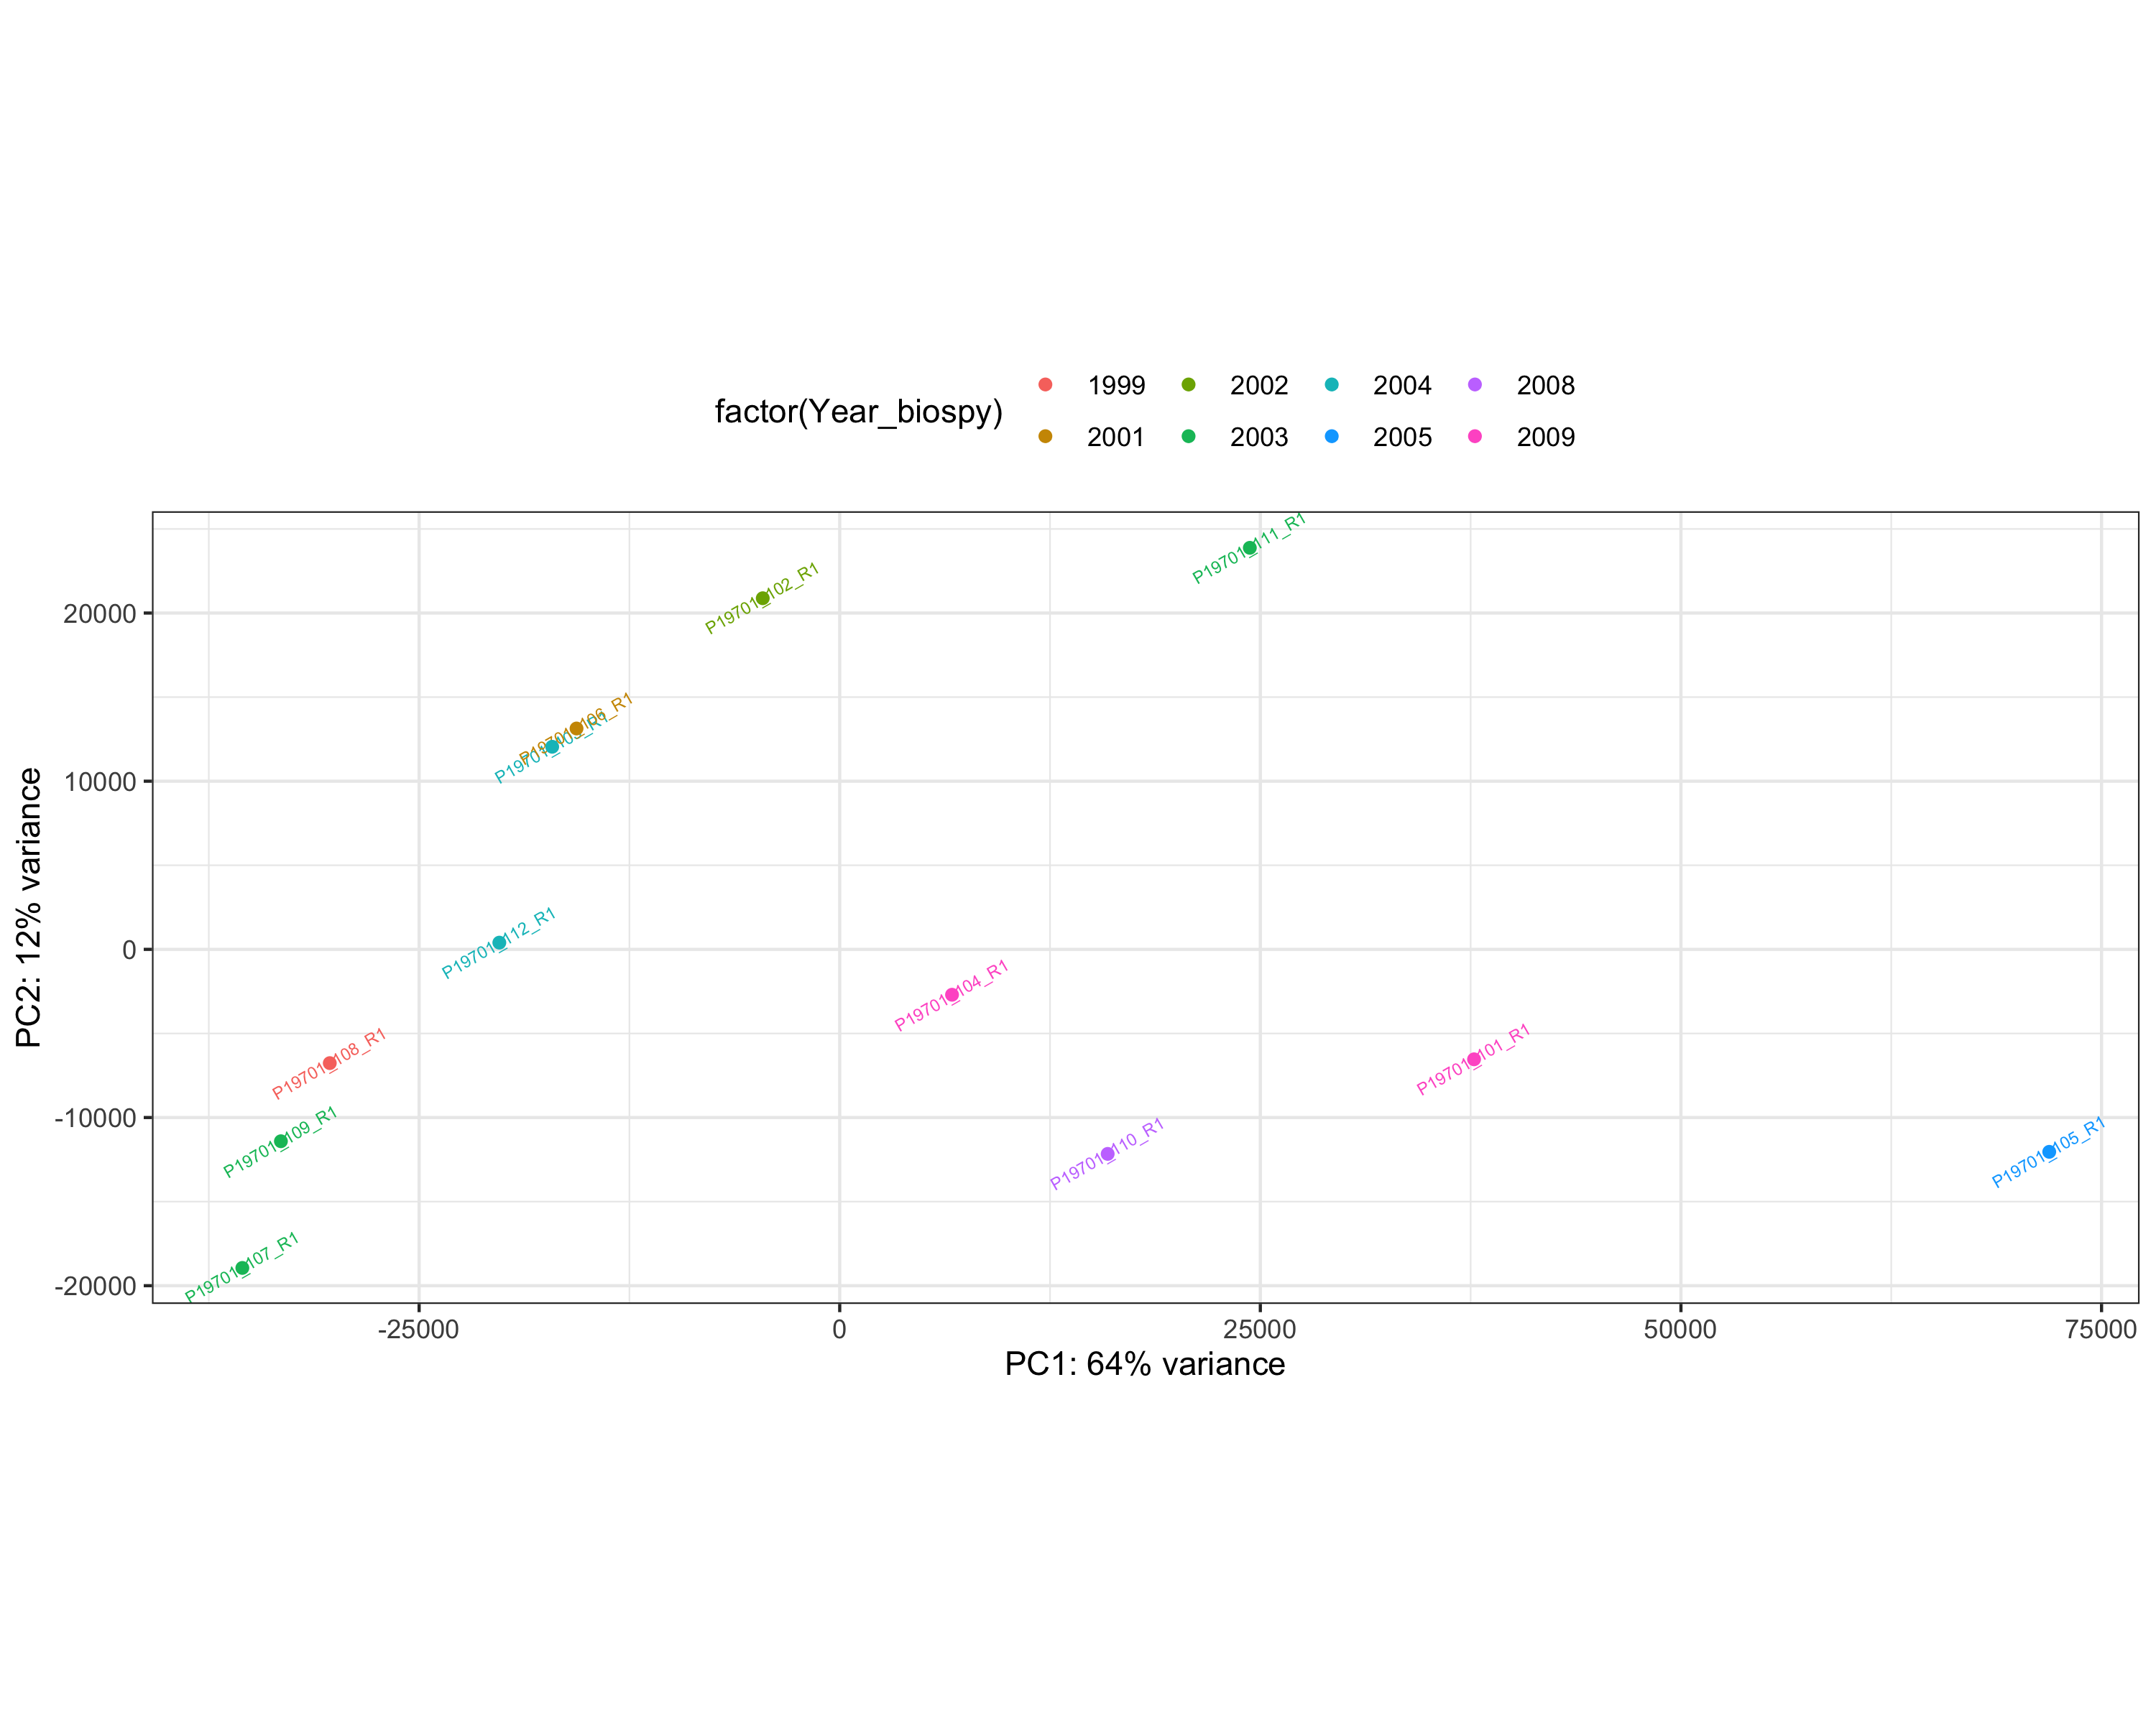
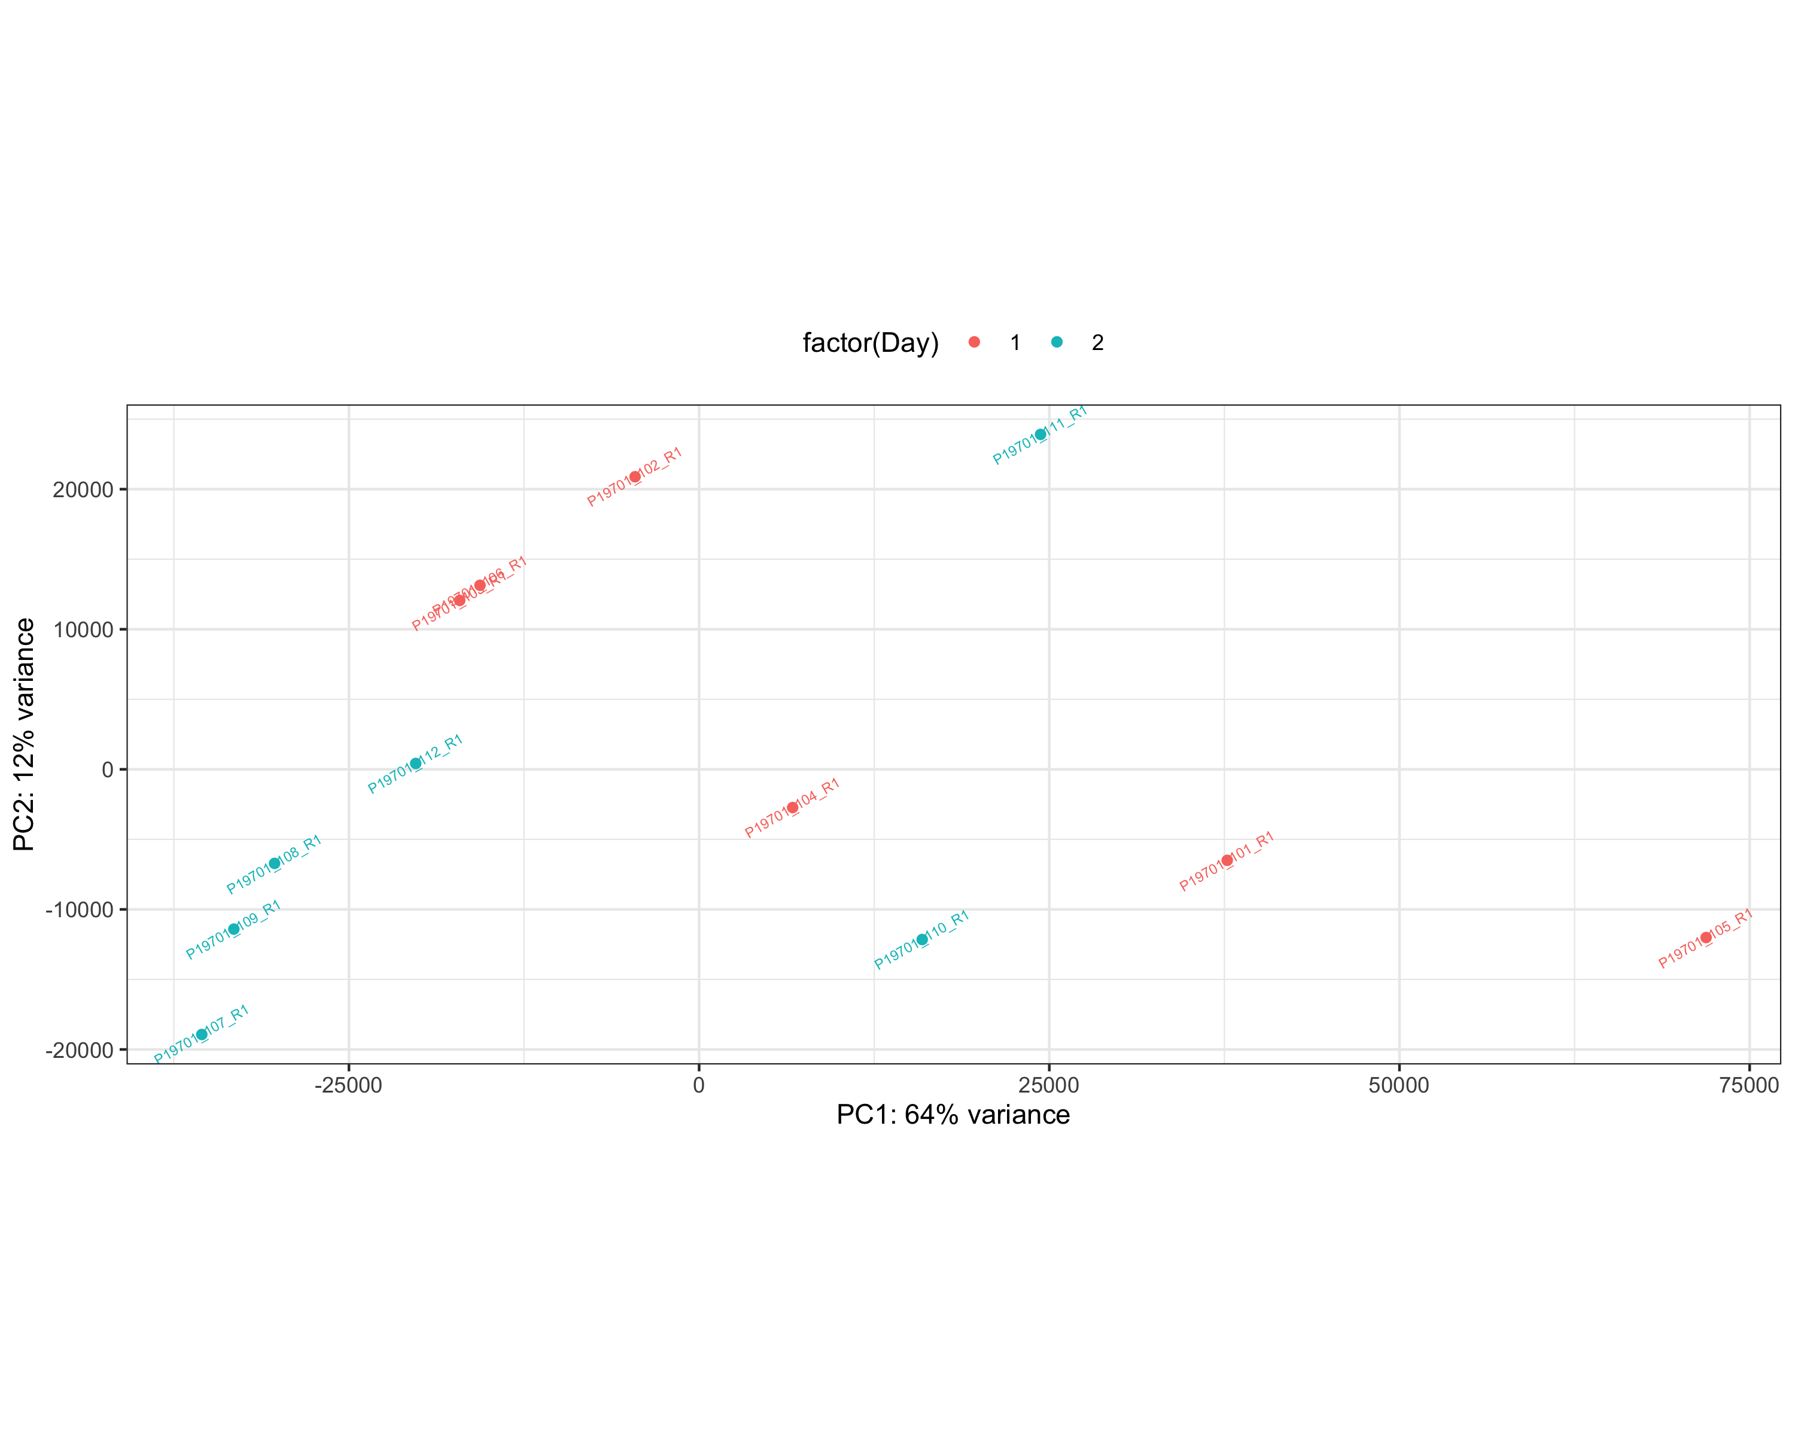
Sample PCA
PCA plot showing scatter of the samples against PC1 and PC2. The color indicates the year in which the samples were taken.
PCA plot showing scatter of the samples against PC1 and PC2. The color indicates the day on which the samples were processed.
Notes:
Sample PCA (Principle Compnenet Analyses) is used to identify any outlier samples. In this case the information on samples included the day in which the sample was processed. There is not a clear trend in terms of samples grouping for any of the two variables provided.

Slide 3
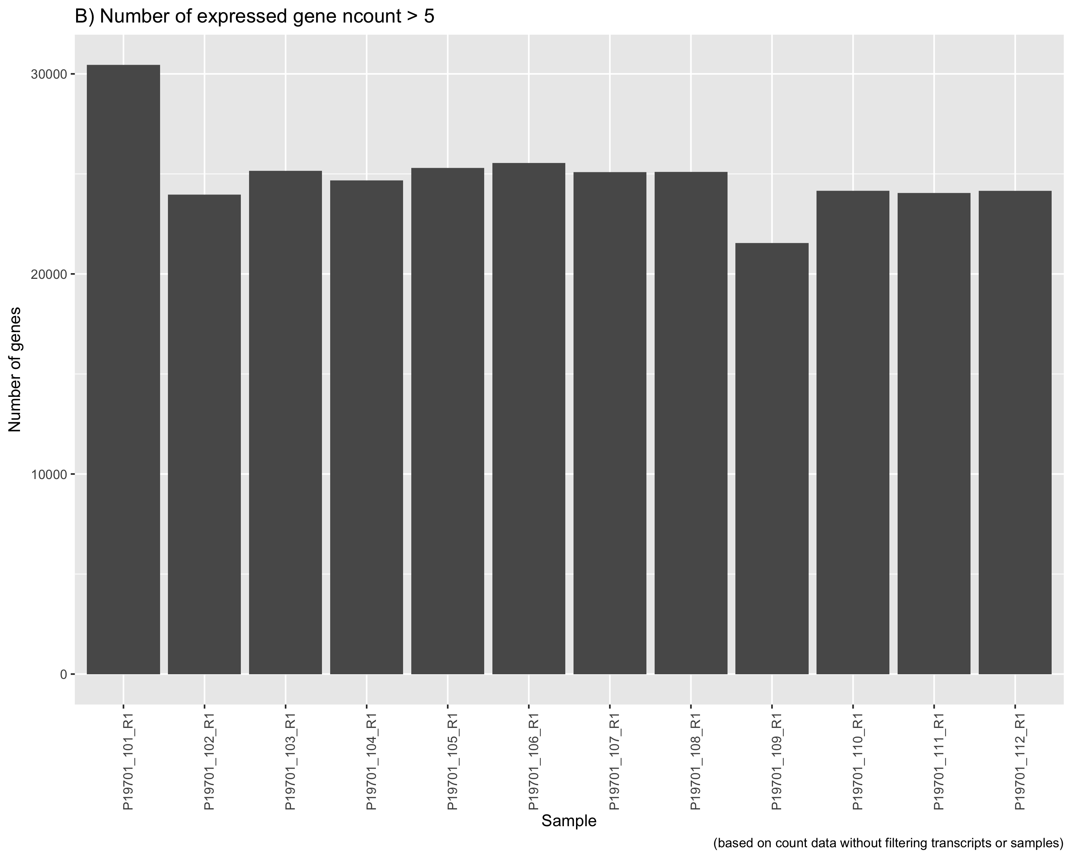
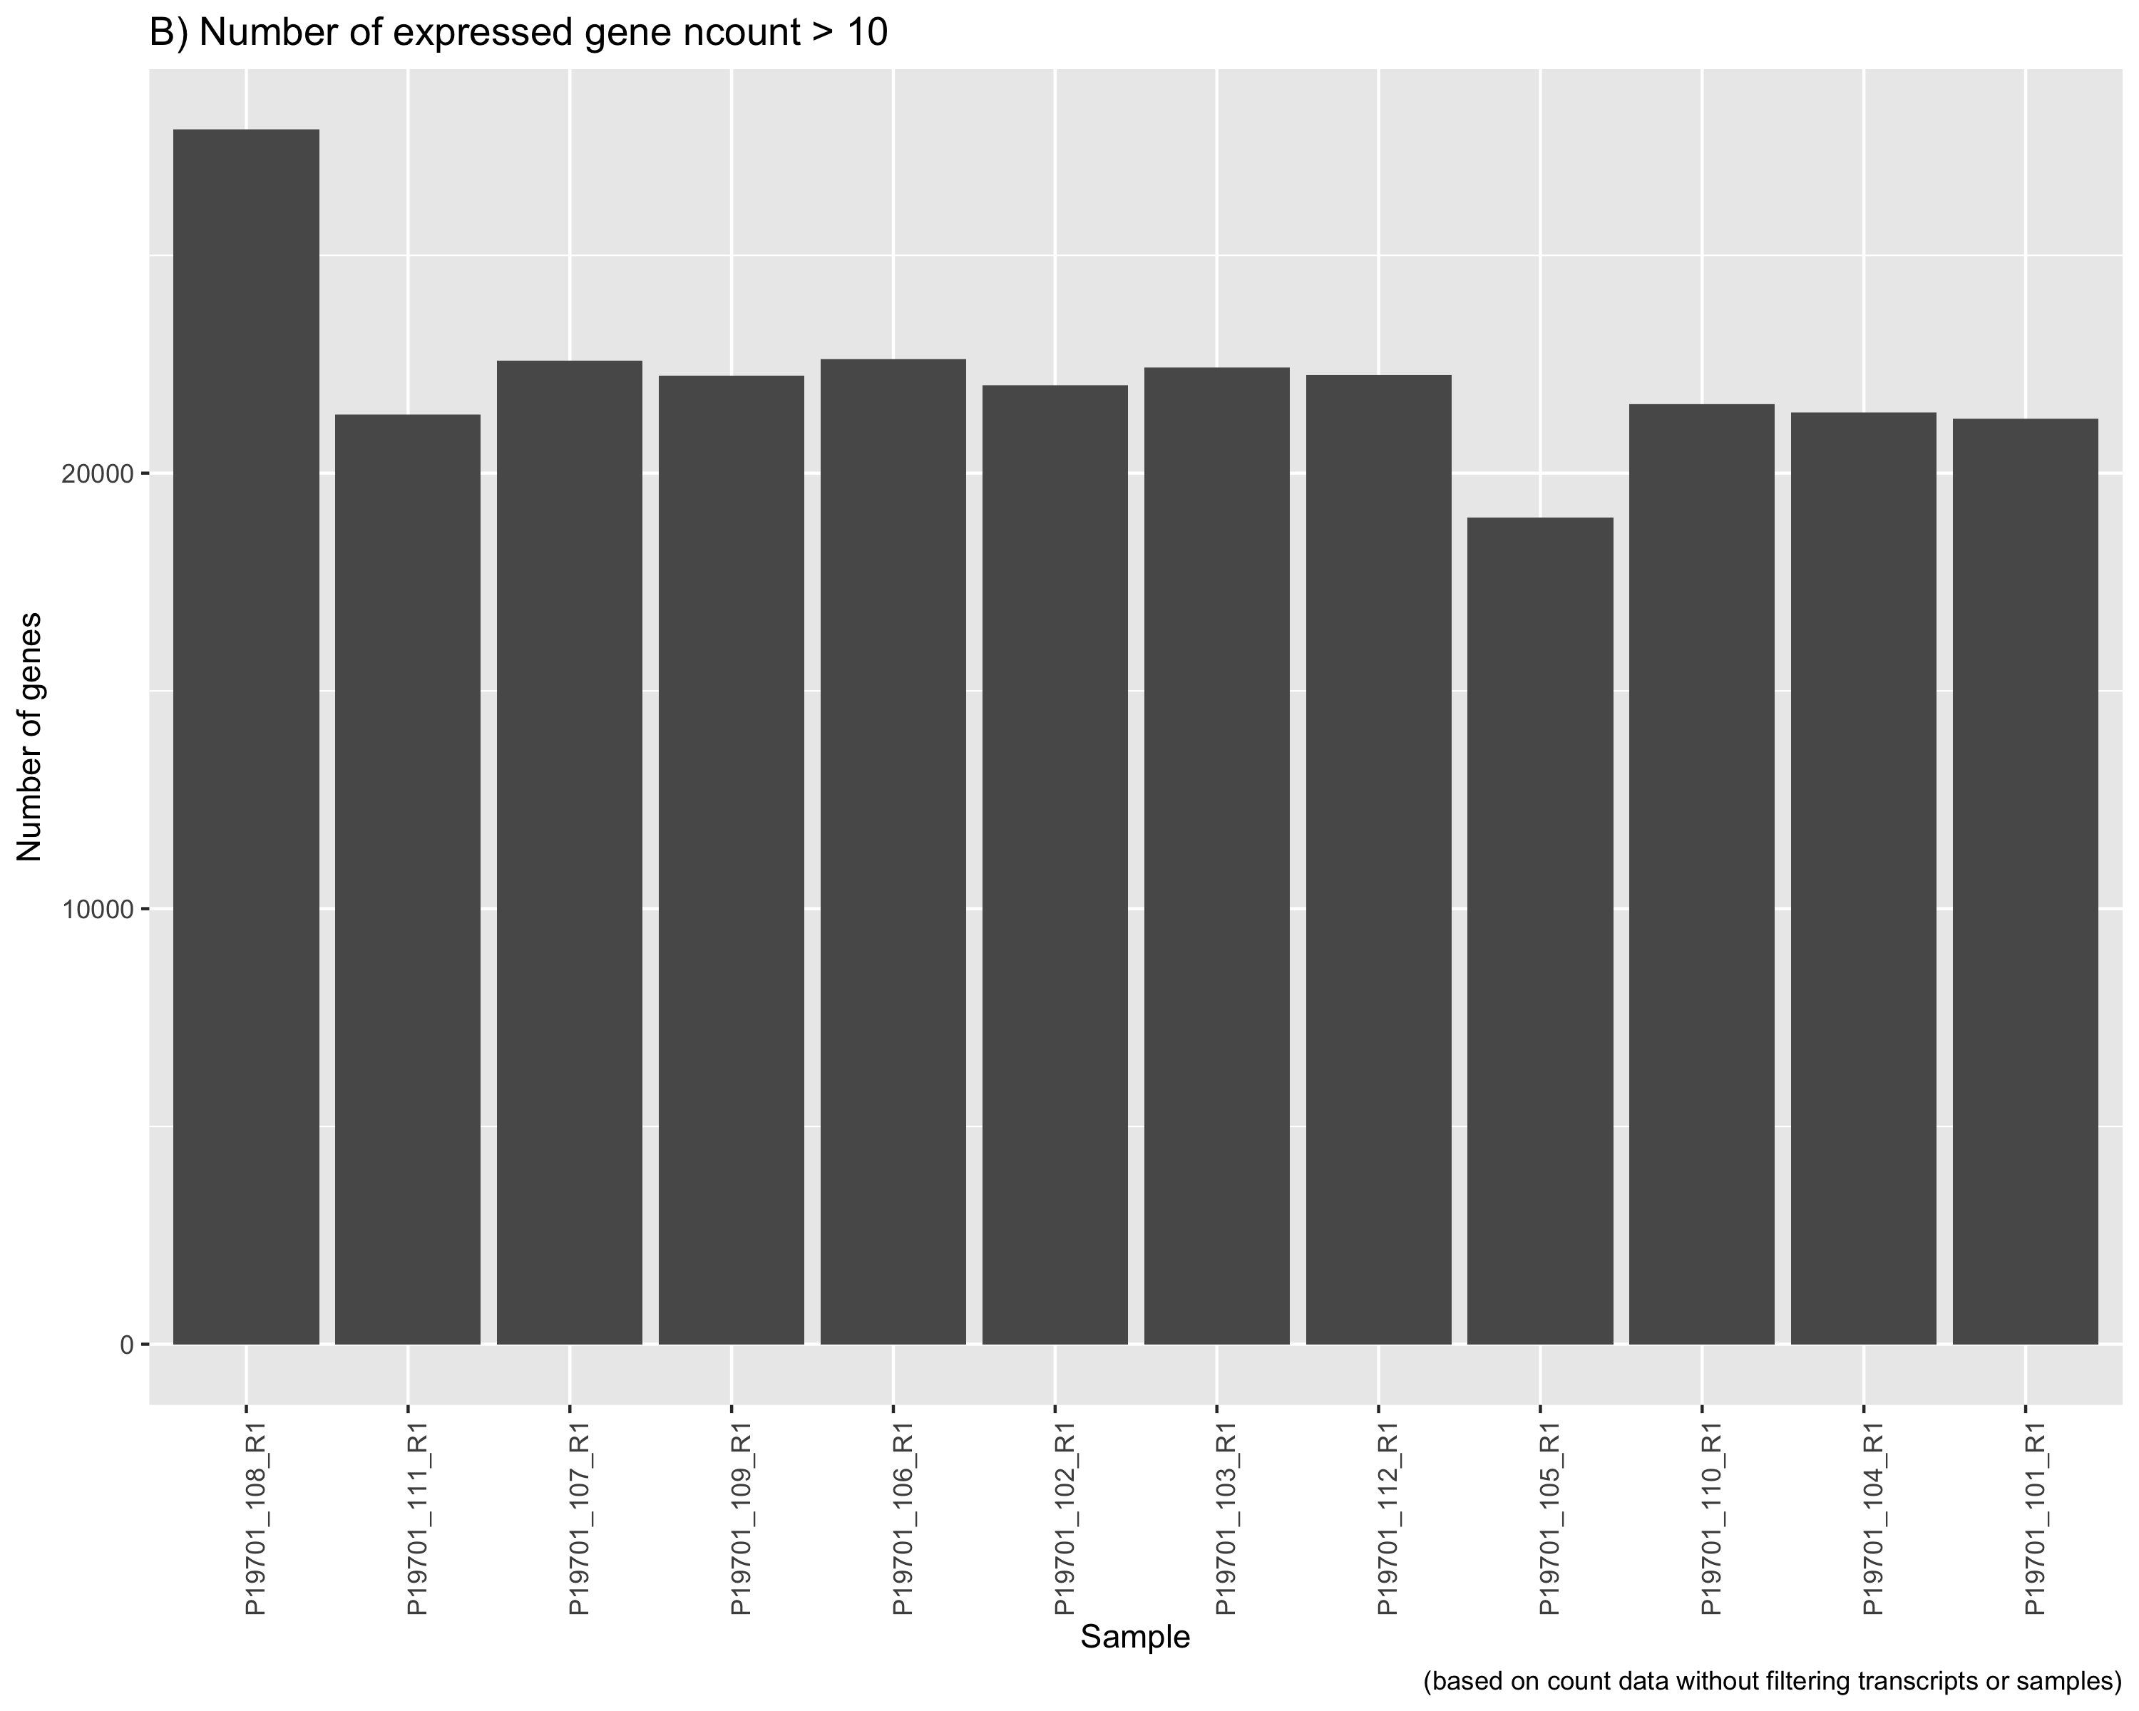
Expressed Genes
The bar plot indicating total number of genes expressed in each of the samples with at least 5 reads mapped to each gene.
The bar plot indicating total number of genes expressed in each of the samples with at least 5 reads mapped to each gene.
Notes:
Total number of gene expressed in a sample to some extent gives an indication of integrity of RNA suggesting the extent at which the transcriptome is covered. Here we see that there are roughly 20000 genes represented with at least 10 reads mapping to each of the genes.

Slide 4
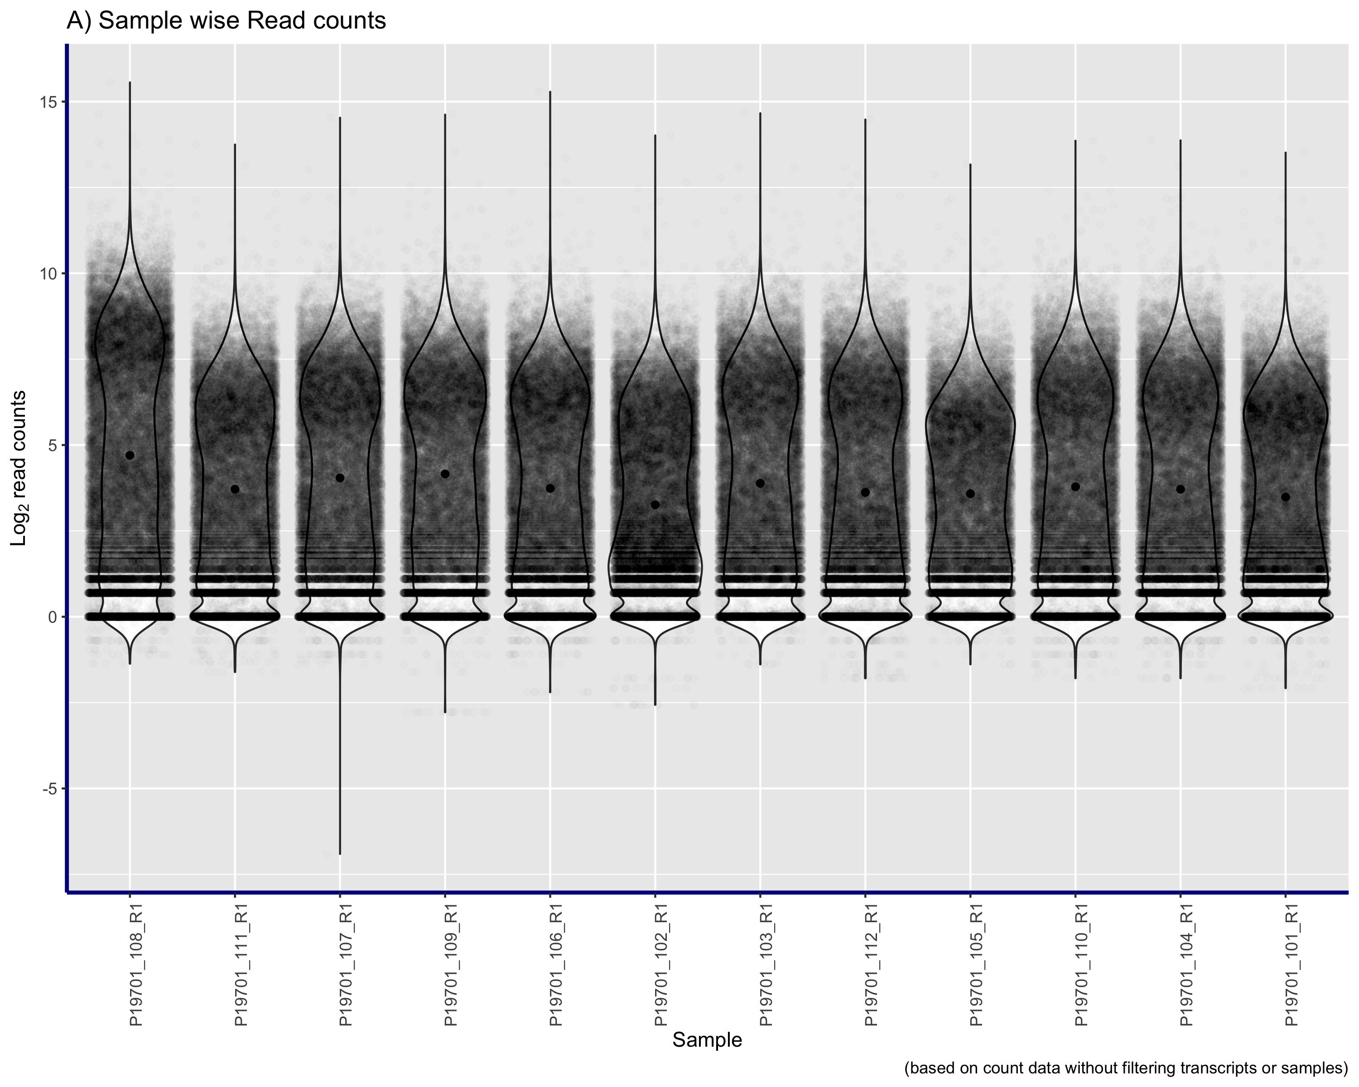
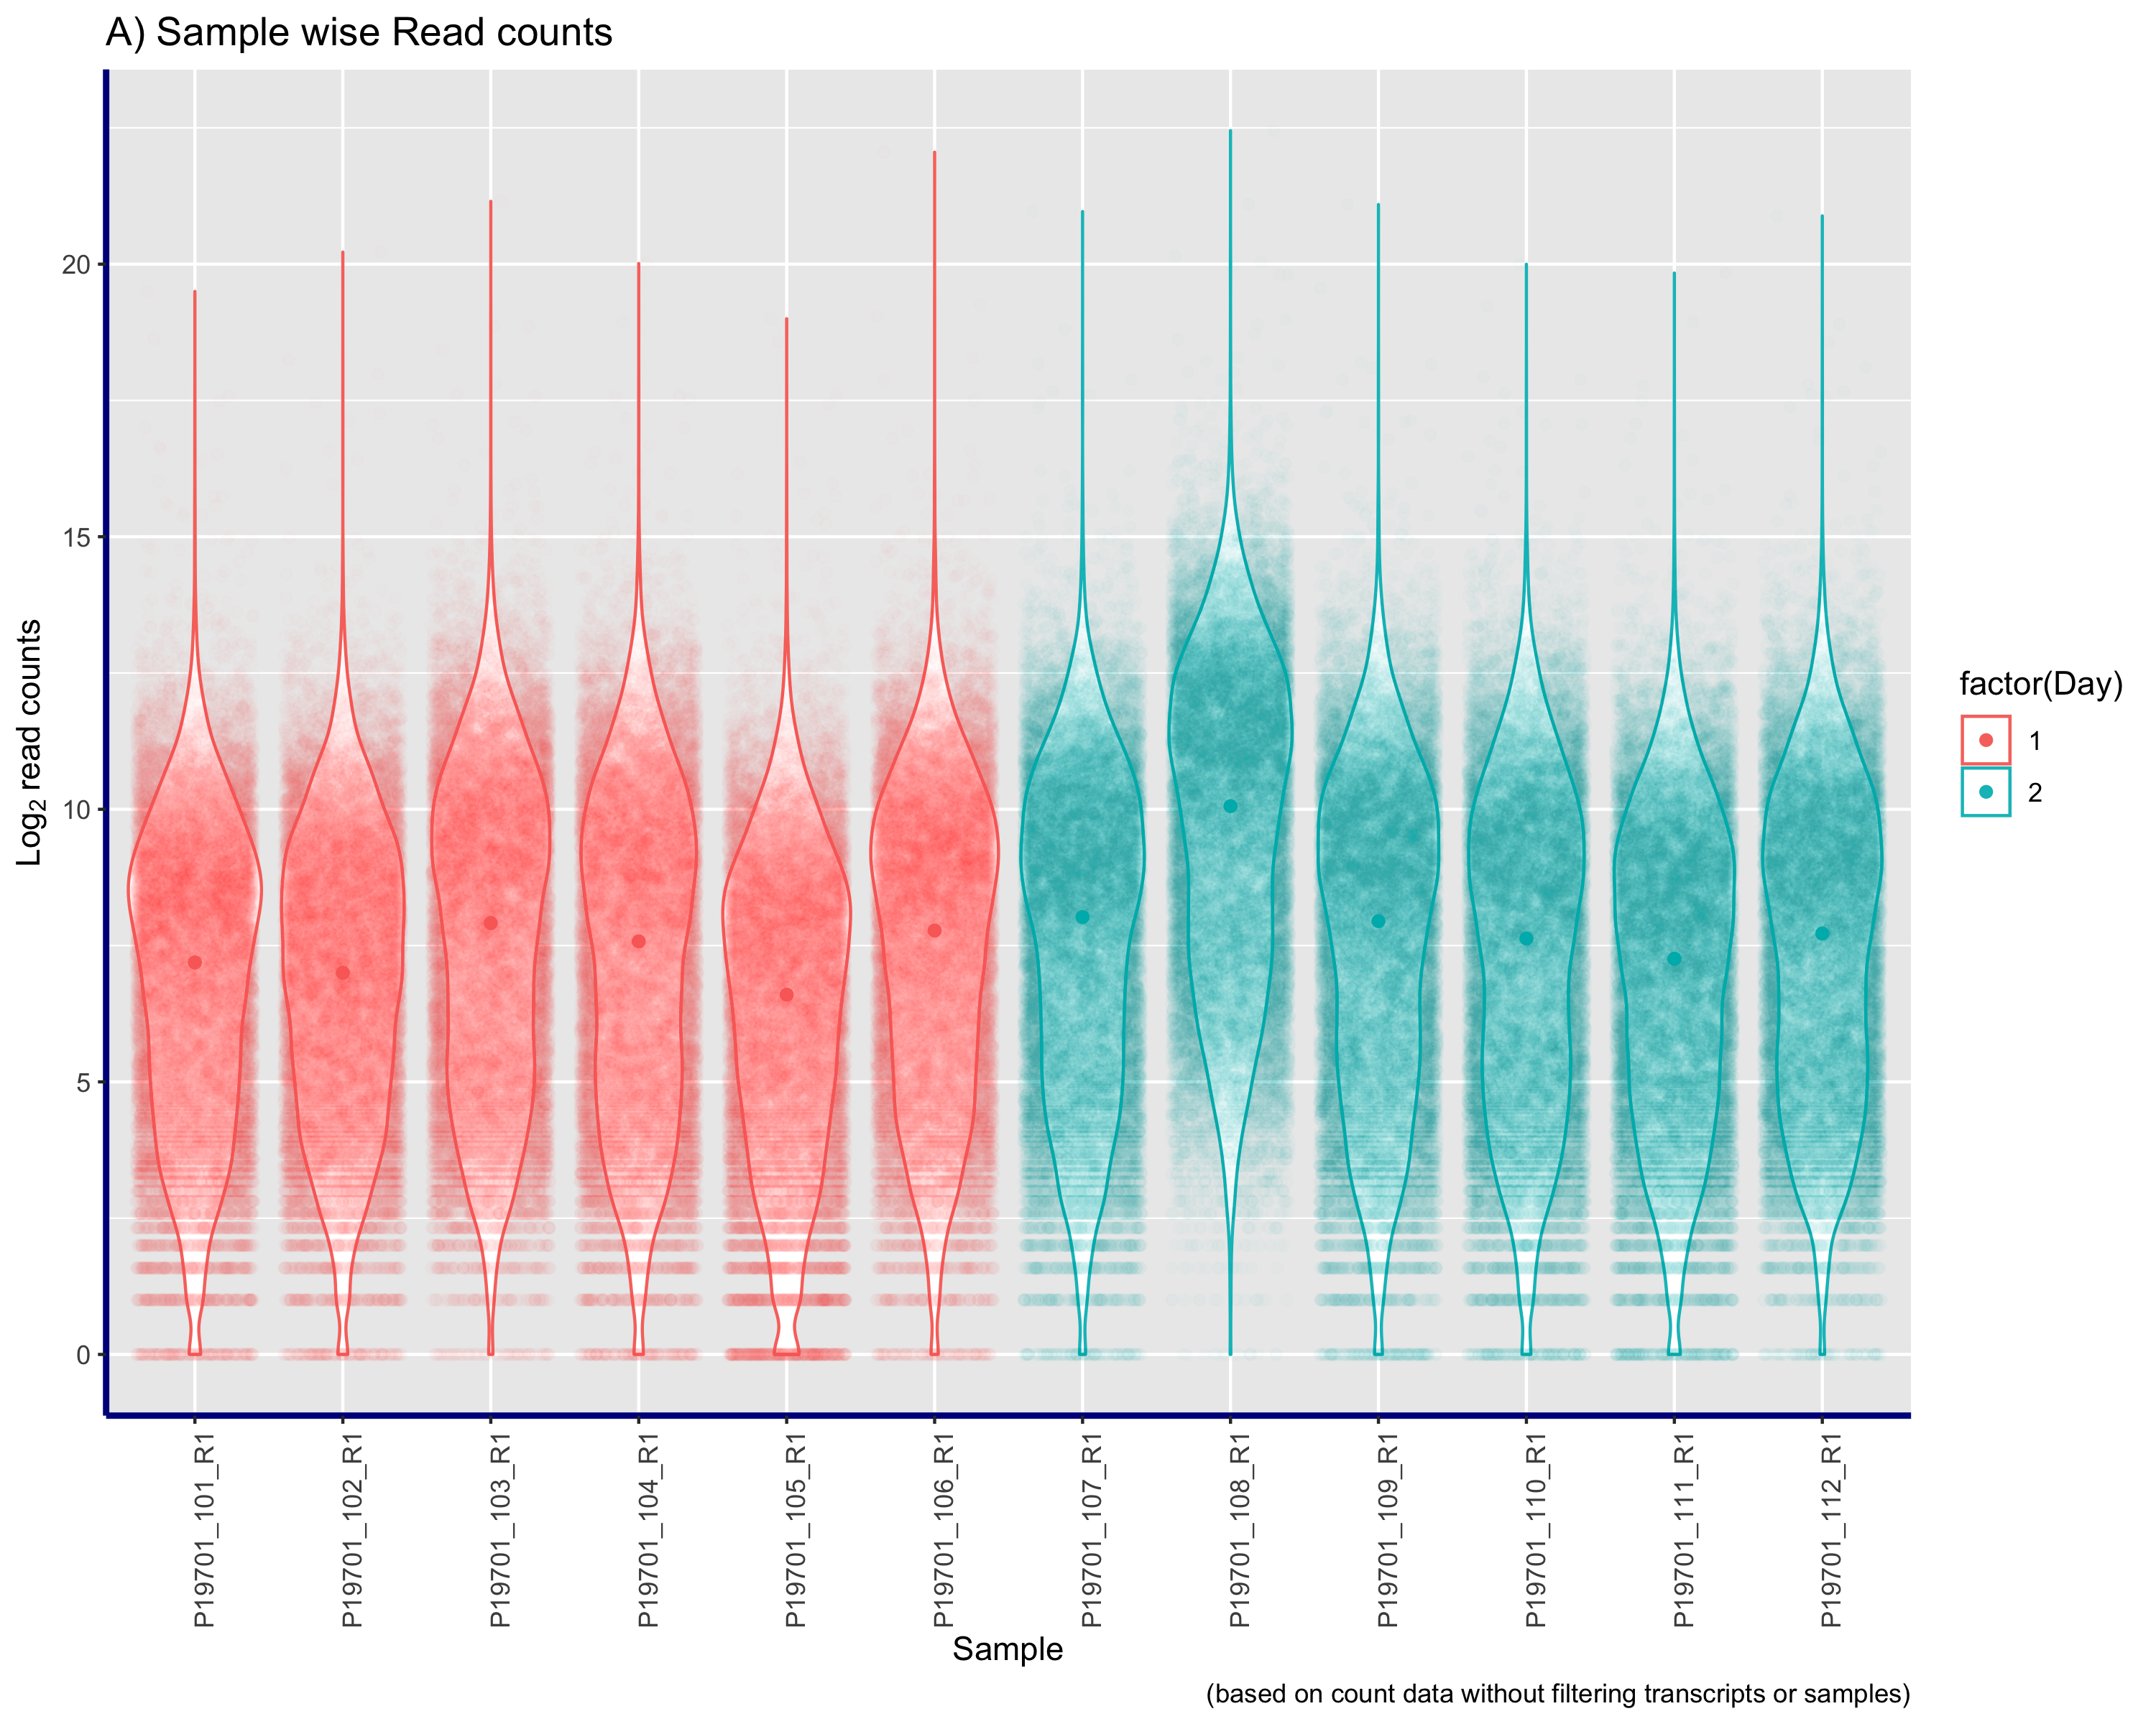
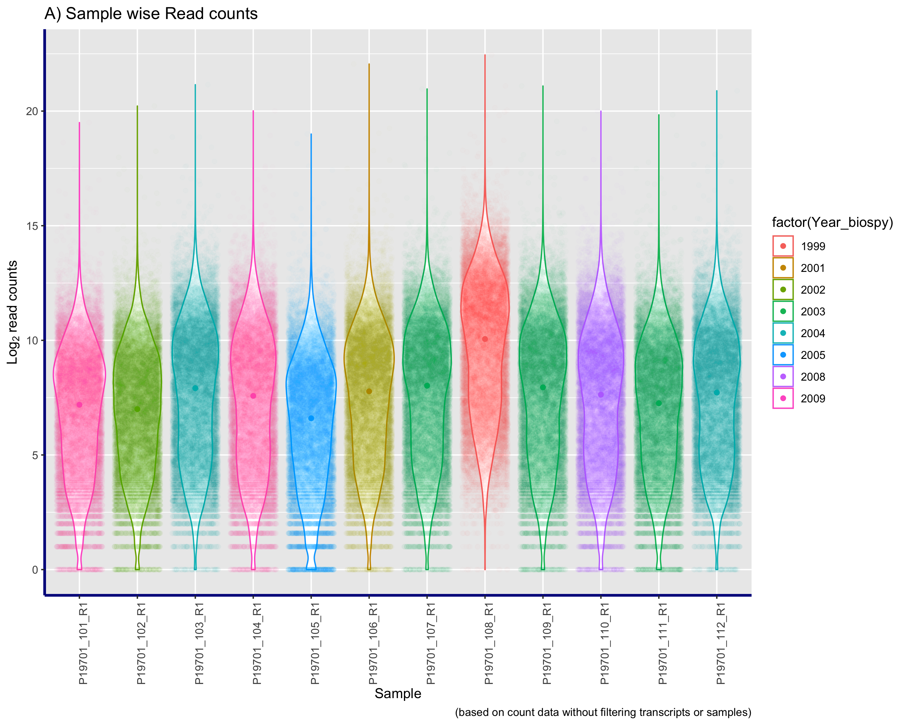
Violin plots
The bar plot indicating total number of genes expressed in each of the samples with at leat 5 reads mapped to each gene.
Notes:
While bar plots of gene counts gives an idea of how many genes are represented across genome, the violin plots show the distribution of the expressed genes in a sample. If mose if the read come from a few genes and over sequencing occurred for those gene, the width of the violin would give an indication of over-represented sequence. Here we see that most of the genes have similar coverage. The distribution across samples appears to be simila with one or two exceptions which would be considered normal for RNA-seq datasets.

Slide 5
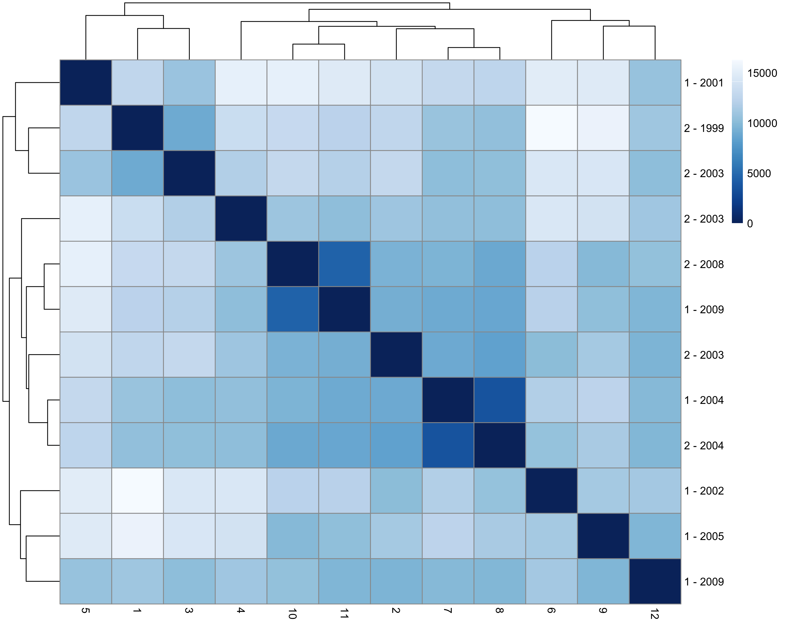
The heatmap plot indicating sample to sample distance.
Notes:
Sample disctance plot would indicate how close samples are to each other based on the read counts. If the grouping variable for phenotype is available, the samples tend to cluster with the phenotype. The same plot can be used to assess whether there are strong batch effects in the data. Here, the batches would be the day and sample preparation and the sampling year. The row annotations indicate that there is no clear clustering with the year or the day of sample preparation.

Slide 6
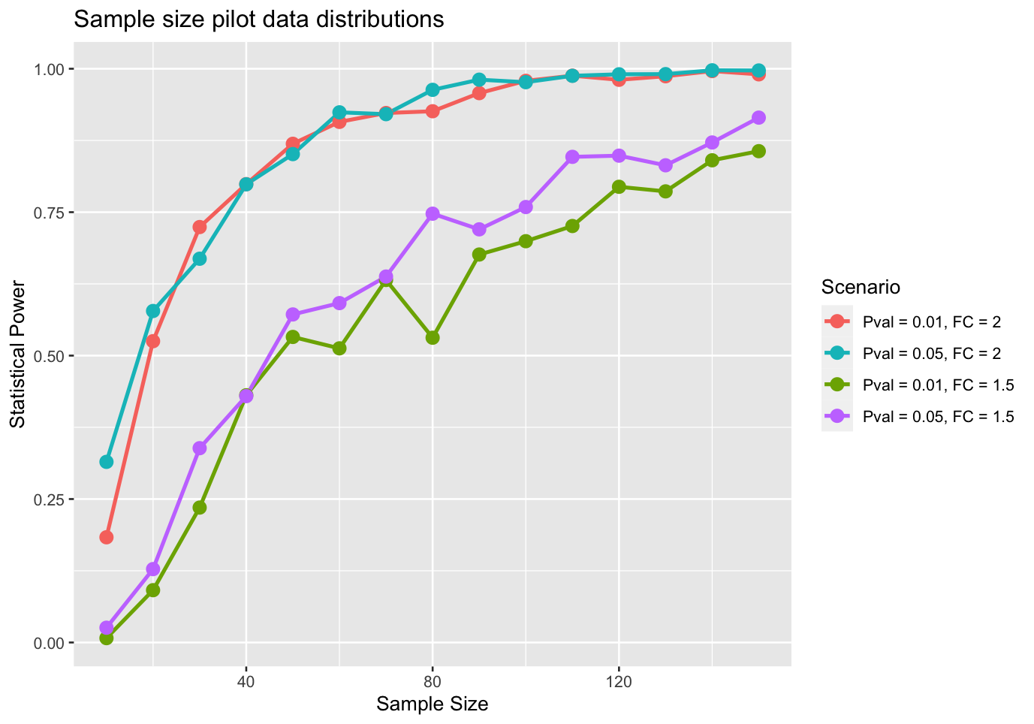
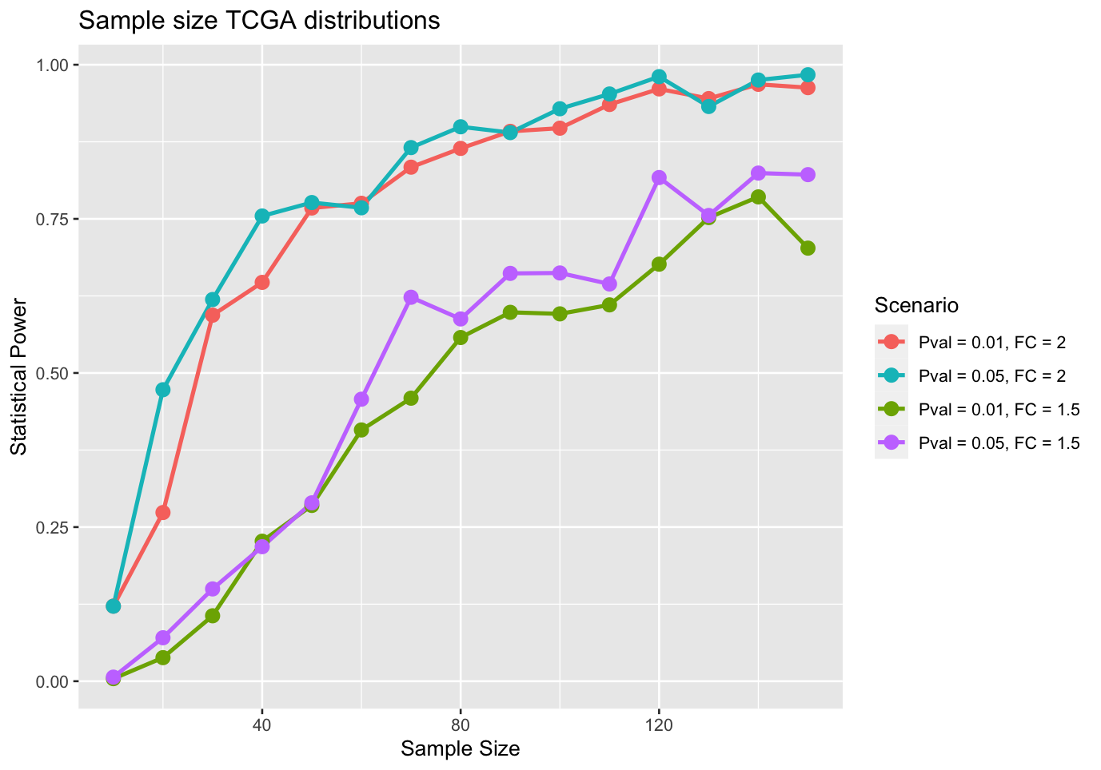
Sample size calculations
Notes:
Sample size calculations to calculate the number of samples requied for sufficinet power can give an idea of the number of samples required to observe a given effect size at a certain significance threshold. For power calculations, the biological coefficient of variation is extrcated from oberved data. In this case we calculated the power based on variation and dispersion estimates extracted from the pilot data and the TCGA prostate cancer data to calculate sample sizes.

